Slide 1
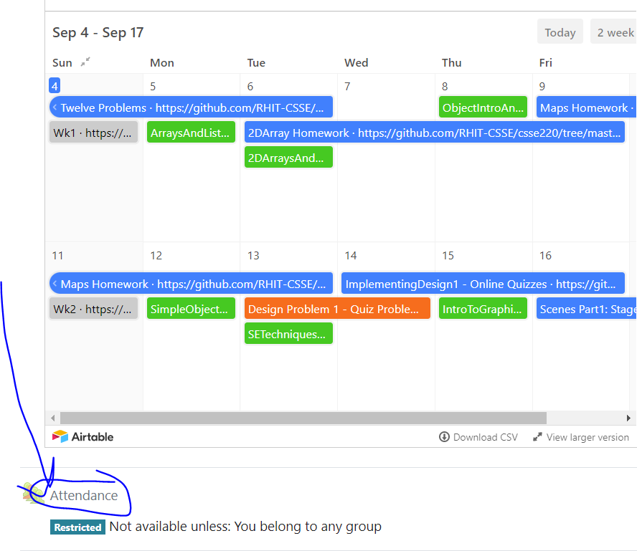
CSSE220 Final Project Tools: Pair Programming and Source Control 101
Today’s Attendance password
teamworkgit
The project for today is just your final code repository
Notes:
We want to introduce roles, answer questions, and then let them work on their project and meet with their TA.

Slide 2
Agenda
Explanation of Normal Pair Programming (Teams of 2 or 3)
Driver and Navigator
Explanation of Remote Pair Programming (Teams of 2 or 3)
Explanation of (Driver, Navigator) Reviewer Role (Teams of 3)
Explanation of Schedule, Agenda, Minute Jobs (Teams of 3)
Source Control Overview
Project Specific Guidelines for using GitHub

Slide 3
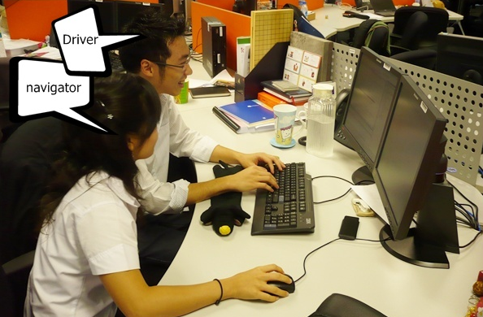
Pair Programming (Normally)
Working in pairs on a single computer
The driver, uses the keyboard, talks/thinks out-loud
The navigator, watches, thinks, comments, and takes notes
Person who really understands should start by navigating
Enable the pair to produce higher quality code than that produced by the sum of their individual efforts
Reduces number of errors
Saves time in the long run
Notes:
Emphasize: Person who really understands should start by navigating (true for our DNR plan as well)

Slide 4
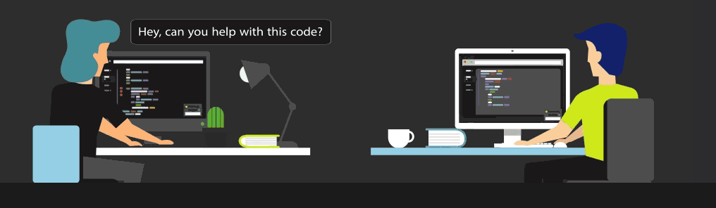
Pair Programming (Remotely)
Working in pairs on two different, remote computers
The driver, uses the keyboard, talks/thinks out-loud
The navigator, watches, thinks, comments, and takes notes
Person who really understands should start by navigating
To allow the navigator to see what driver is doing, you must use some kind of tool such as
Screen sharing via MS Team (or Zoom/etc)
https://www.codetogether.com/ Eclipse plugin allows you to work together through a browser
If you have trouble sharing screens because of internet bandwidth issues or find it too clunky:
the https://www.codetogether.com/ Eclipse plugin might be a good tool for you and your partner to use
You could do a phone call or audio only call via MS Teams
Similarly, remote pair programming enables the pair to produce higher quality code than that produced by the sum of their individual efforts
Driver
Navigator
Notes:
Emphasize that there is only code on one computer, which can be helpful as we will need later.

Slide 5
Things to DO
Meet Regularly – setup times when you will regularly work on the project
Talk – not a minute should go by when you are not communicating
Listen – each partner should be fully involved in the project
Rotate Roles – change roles to gain new perspectives and share the work
Be Patient – It’s a virtue, by explaining yourself, you help yourself learn
Respect – everyone has something to offer
Take Breaks – When you return, you may notice something you missed
Prepare – Do any preliminary work ahead of time (not code)
Have Fun – Working with someone else can be a lot more fun!
Notes:
These might seem like common sense, but they are critical to mention!

Slide 6
Things NOT to do
Don’t: Force your opinion as the only option
Always assume your partner(s) may have equally good ideas to contribute!
Don’t: Be intimidated
You know more than give yourself credit for!
Don’t: Be Quiet
Don’t be afraid to speak up if you don’t agree with your partner(s)!
Don’t: Suffer in Silence
If you have a problem with your partner(s), let your TA or professor know right away!
Notes:
These might seem like common sense, but they are critical to mention!

Slide 7
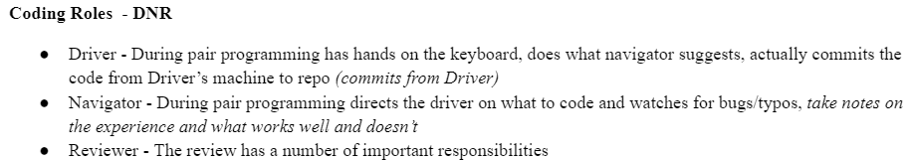
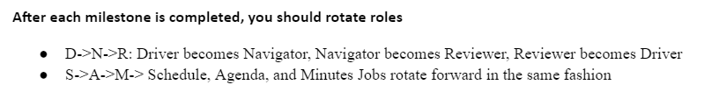
DNR: Driver, Navigator, Reviewer
Notes:
The driver and navigator roles have been discussed already.
Deliverables:
Driver is responsible to make commits
Navigator is responsible to take notes on experience to share during TA meeting
Review- more on next slides

Slide 8
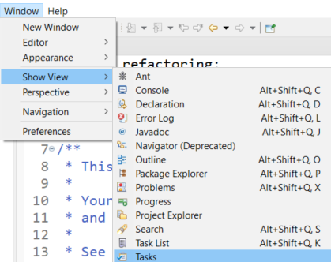
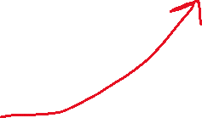
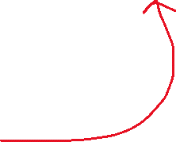

DNR: Driver, Navigator, Reviewer
Reviewer - The review has a number of important responsibilities
Look at each piece of code and either correct or mark TODOs in the code
If its easy and obvious, just fix it
If NOT, add a TODO to complete later
Eclipse can provide a view of your TODOs in a project
Generate the PlantUML for the current project and next Milestone before the TA meeting
Use to easily generate UML: https://plantuml.com/eclipse
Can copy the source code and modify as needed
Identify violations of the 5 OODP based on code and UML
Mark TODOs in code or add comments to review document (notes for meeting with TA)
Provide a log of the results of the review
This is easily done with a good commit record
Evaluation of the current UML
Production of the planned UML for the next milestone with notes
During the TA meeting, the reviewer will discuss their review of the code and discuss concerns they have

Slide 9
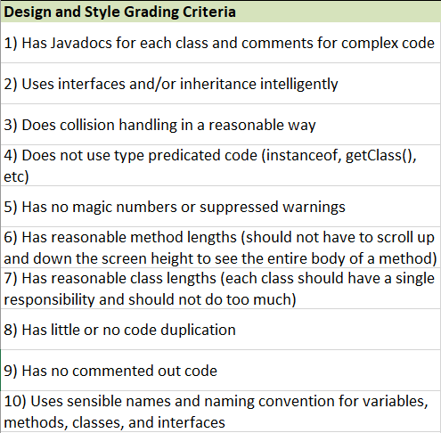
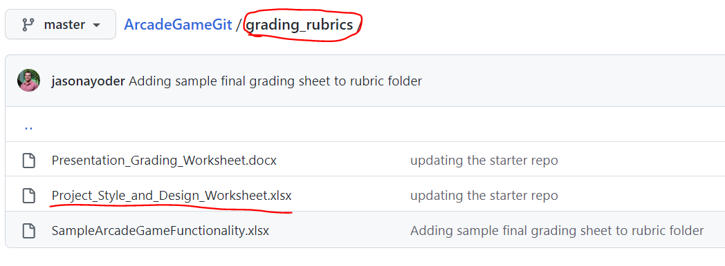
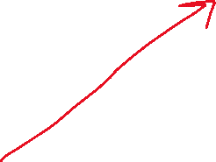
Final Style and Design Rubric

Slide 10
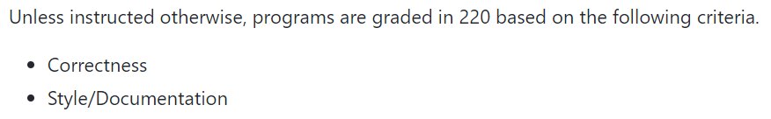
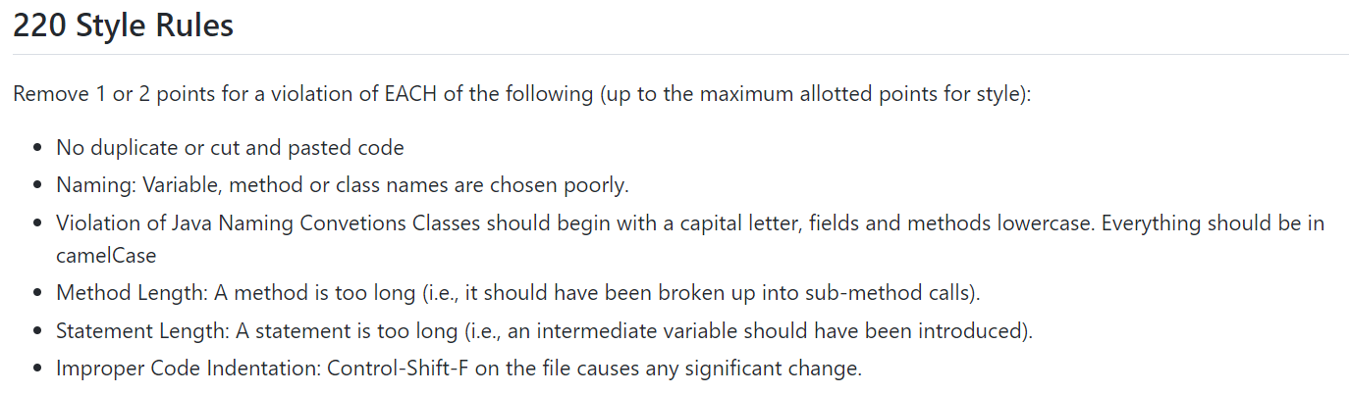
CSSE220 Grading Instructions
https://github.com/RHIT-CSSE/csse220/blob/master/Docs/grading_guide.md

Slide 11
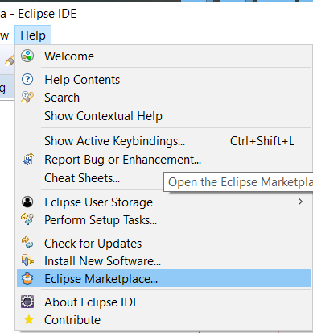
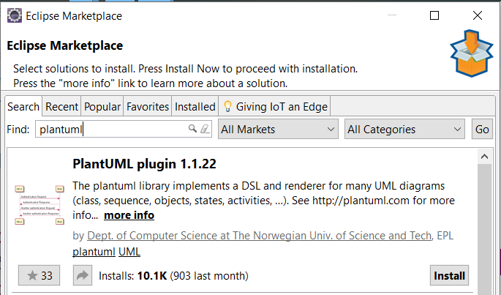
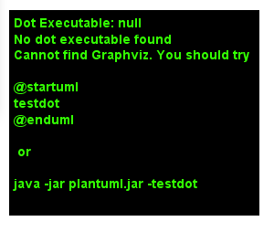
PlantUML Eclipse Plugin
https://plantuml.com/eclipse
https://graphviz.gitlab.io/download/
Windows Stable Installed (msi)
Install Graphviz

Slide 12
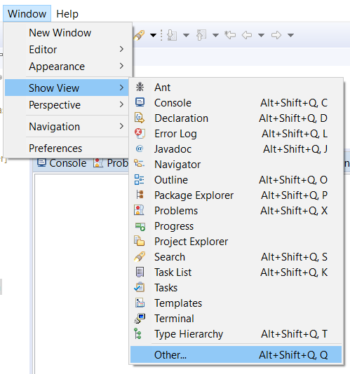
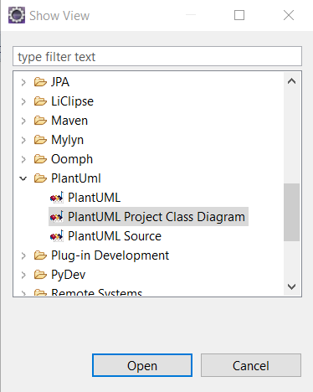
PlantUML Eclipse Plugin

Slide 13
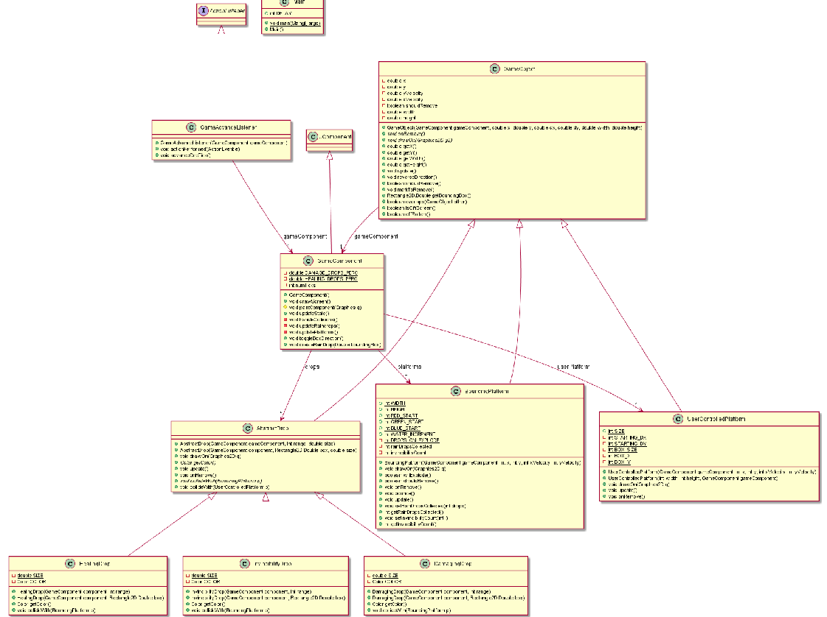
Information Overload
As project gets larger
It becomes too hard to understand from a giant UML
You can modify it easy…
(Next Slide)

Slide 14
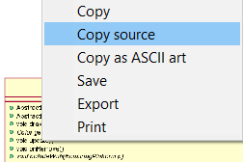
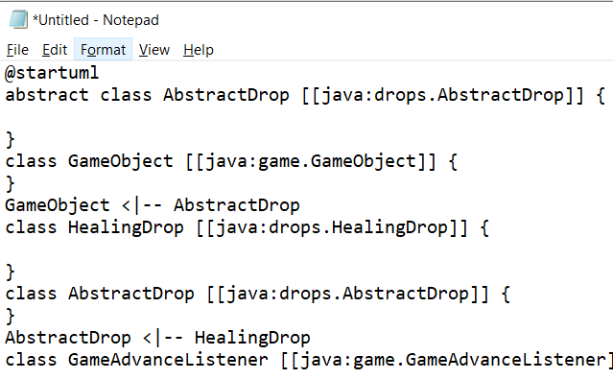
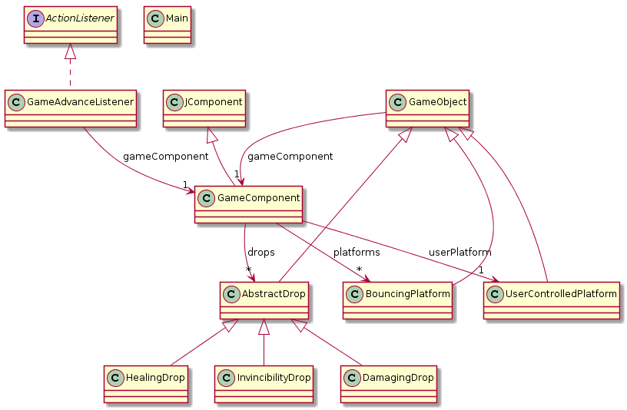
<- Copy UML source and
then remove extra ->
PlantUML
Eclipse
Plugin

Slide 15
SAM: Schedule, Agenda, Minutes
Driver = Schedule Job
Navigator = Agenda Job
Reviewer = Minutes Job
Organizational Roles - SAM roles should rotate with the DNR roles DNR/SAM (DS, NA, RM)
Schedule - Is in charge of determining when the group of 3 and 2 will meet. Should be the Driver
Agenda - Is in charge of defining what will be discussed/worked on and in what order during meetings/work (Should be Navigator)
Minutes - Is in charge of recording the meeting “minutes” which provide a brief summary of key talking points for the group to refer to. (Should be Reviewer)
Here is a sample template you are welcome to use for taking notes during your meetings
TeamName - Meeting Template (updated)

Slide 16
Example: Meeting 10/24/2022 Time: 7:00-9:00pm Present: Allison (D), Brandon(N), Charlie(R)
Agenda:
Discuss changes to codebase (Allison will lead this part of the meeting)
Refactored code to separate drawing from updating game elements
We need a decision about what to put into the abstract class
2. Discuss Reviewer feedback on OODP (Charlie will lead this part of the meeting)
Cohesion seems low in the GameRunner class
Do we need a separate Knight and Ostrich class?
3. Discuss Plan for TA Meeting (Brandon will lead this part of the meeting)
Brandon can talk about how screen sharing worked vs. using one machine
Charlie has the UML ready for current UML
Work together to design Milestone 2 UML
Minutes:
1.a Everyone agrees this was a good move and helps us out
1.b We agreed that ________ all should go in there as well as the method ____
2.a We all agreed that we should pull some functionality out and move into other classes
2.b We decided that we definitely should ______
3.a Brandon’s talking points ready and everyone said they seemed ready for the TA meeting
3.b Charlie showed us the dump of the PlantUML plugin but its a bit too much, Charlie agreed to work on revising it to have less of the information
3.c We got a good start on the Milestone 2 UML, but need to need again before the next TA meeting, but not until after Charlie gets a draft ready
Next Actionable Steps:
Driver (Allison) will send out a when2meet poll for Thursday to find a meeting time
Navigator (Brandon) will set the agenda for the next meeting
Reviewer (Charlie) will complete the M2 draft by Wednesday night
For Next Milestone: D->N->R (Driver becomes Navigator, Navigator becomes Reviewer, Reviewer becomes Driver)
Charlie (driver), Allison (navigator), Brandon (reviewer)

Slide 17
Agenda
Explanation of Normal Pair Programming (Teams of 2 or 3)
Driver and Navigator
Explanation of Remote Pair Programming (Teams of 2 or 3)
Explanation of (Driver, Navigator) Reviewer Role (Teams of 3)
Explanation of Schedule, Agenda, Minute Jobs (Teams of 3)
Source Control Overview
Project Specific Guidelines to using Github

Slide 18
If a team of developers is collaborating on a project why can't you use something like Dropbox to keep in sync?
Question:

Slide 19
If a team of developers is collaborating on a project why can't you use something like Dropbox to keep in sync?
Question:
Answers:
If two people are editing different files at once it is likely to break the code
If two people edit the same file it is easy for one save to destroy changes made by an earlier save

Slide 20
Source control is syncing help for developers
Your changes are broken into "chunks" called commits that can change multiple files at one time on a local copy
You only sync with the shared repository when you intend to
Source controls system allows you to go back to any historical version
The source control system will prevent you from accidentally destroying someone else changes by overwriting files they changed

Slide 21
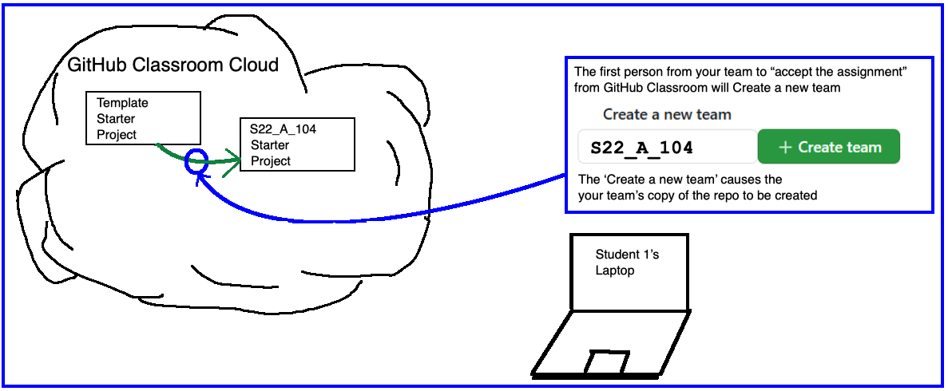
The FIRST student should do this and CREATE the team with the proper name from the Team/TA Spreadsheet
The SECOND/THIRD team members should JOIN the team that the first student created.
When this team is created, then a code repository (repo) is generated automatically
This new code repo is where you will be storing your code for the final project.

Slide 22
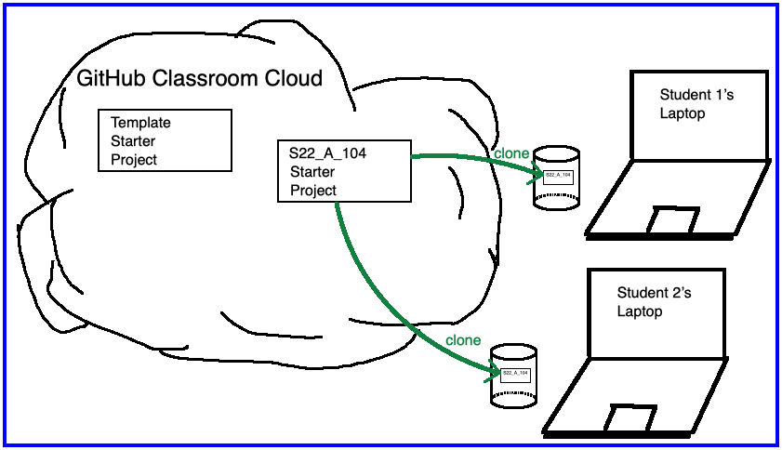
The code repo you created and team members joined is located in the GitHub “Cloud”
You will CLONE the repo locally, which means you copy the files to your laptop
You will make changes and PUSH them back into the GitHub “Cloud” for safe keeping and to share with teammates

Slide 23
Team Version Control
Version control tracks multiple versions
Enables old versions to be recovered
Allows multiple versions to exist simultaneously
Always:
Pull BEFORE working
Pull AGAIN before committing
Commit + Push often and with good messages
Communicate with teammates so you don’t edit the same code simultaneously
Pair programming ameliorates this issue ☺
Q2
Notes:
QUIZ QUESTION 2
If you only use one computer then this will never happen.

Slide 24
Git basic workflow
Before you start work, you PULL, syncing your local system with any changes other developers have made to the shared repository since you last worked
On your local copy, you add some code, make a feature, etc.
You PULL again just in case something else go updated when you were working (i.e. your partner made a change)
When you are finished, you combine (ADD) all your changes into a COMMIT and PUSH that makes changes to the shared repository

Slide 25
What if Two+ People Edit the Same Code?
Math.java
Alice edits sqrt method
Bob edits sqrt method
Alice commits and pushes changes
Bob attempts to commit and push changes
ERROR
Source control system cannot
resolve multiple changes on the
same code, Bob should have
updated and resolved conflicts
before committing.
Updated Math.java

Slide 26
Team Version Control Simple Workflow
git clone
(one time)
Pull and
Commit + Push often!
Pull BEFORE editing!
Pull
Edit
Commit + Push
Pull
Pull BEFORE committing!
Notes:
Update before editing or committing to make sure you don't get out of sync with changes made by others (like your instructor, or later your teammates).

Slide 27
Git more complicated workflow
Before you start work, you PULL, syncing your local system with any changes other developers have made to the shared repository since you last worked
On your local copy, you add some code, make a feature, etc.
You try to COMMIT and PUSH, but it fails because your code was not up to date
On the PUSH, git usually gives an error reading: ''not fast forward"
So, you PULL again
On your local system, git potentially marks several of the code files to be in conflict, you fix the conflicts in your code by making more edits
You test your code
You stage the changed files (ADD)
You COMMIT and PUSH

Slide 28
Fixing conflicts – what it looks like
SomeFile.java
SomeCode
>>>>>>>>> HEAD
YourCode();
==========
TheirCode();
<<<<<<<<<<
MoreCode
You will see eclipse errors – do not get weirded out
Realize that you are merging two branches of the code
Edit the code to fix the problems
Do not forget to test

Slide 29
To Reduce the Occurrence of Conflicts
Always PULL before you begin coding
Quickly COMMIT/PUSH after you finish
Pair program so each member of the team is not modifying the same code in two DIFFERENT local copies at the same time
https://www.codetogether.com/ Eclipse plugin allows you to both edit, but it is only linked to ONE local set of files.

Slide 30
Git Problem Resolution Guide
How to update to latest version of code when you don’t care about your local changes (i.e. Team->Pull gives a “'not fast forward“ error)
Replace With-> HEAD and then Pull (removes all local changes)
Still unable to Pull?
Simply delete project and re-clone
Want to revert to an earlier commit? Simplest way:
clone the repo again as a new project (use a different name for new project)
checkout the version you want (How to go to previous commits in eclipse and egit)
Dr. Holly's Guide on How to Checkout the Git History
copy the files you want from this new project into your original and then commit + push
delete the new project since you don't want to get them mixed up

Slide 31
Code Together Workflow
Driver initiates a CodeTogether session and shares it with Navigator
git clone
(one time, both Driver and Navigator)
Pull
(Driver’s computer)
Navigator connects and then watches and gives feedback via phone/conference call
Navigator: Pull
(files are now on Driver, Navigator, AND github.com)
Driver: Commit + Push
(files are now on Driver and github.com)
Driver + Navigator work together to make progress and then save their files
(only on Driver’s computer)
Pull
Pull just to be safe here
Notes:
Update before editing or committing to make sure you don't get out of sync with changes made by others (like your instructor, or later your teammates).

Slide 32
Remote Programming Code Edits Visualized
Github.com repo
Main.java
David (Driver)
Natalie (Navigator)
Clone
Github.com repo
Main.java
David (Driver)
Main.java
Natalie (Navigator)
Main.java
Edit
Github.com repo
Main.java
David (Driver)
Main.java
Level.java
Natalie (Navigator)
Main.java
Commit +
Push
Github.com repo
Main.java
Level.java
David (Driver)
Main.java
Level.java
Natalie (Navigator)
Main.java
Github.com repo
Main.java
Level.java
Pull
David (Driver)
Main.java
Level.java
Natalie (Navigator)
Main.java
Level.java
Notes:
Update before editing or committing to make sure you don't get out of sync with changes made by others (like your instructor, or later your teammates).

Slide 33
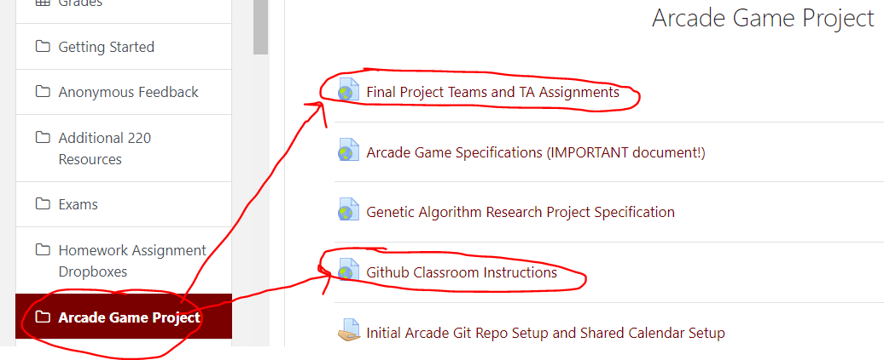
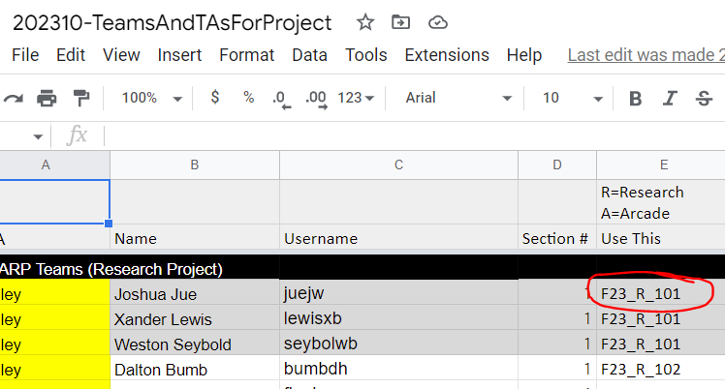
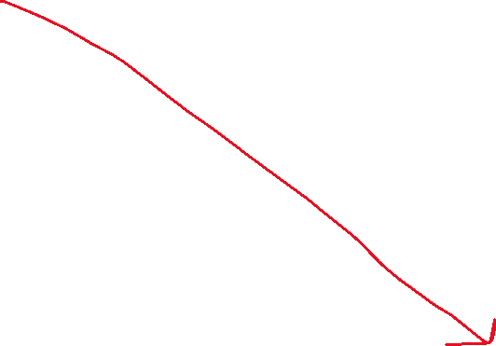
Practice
With your team, follow the instructions to get your repo setup
You will submit your Final Project from your repo

Slide 34
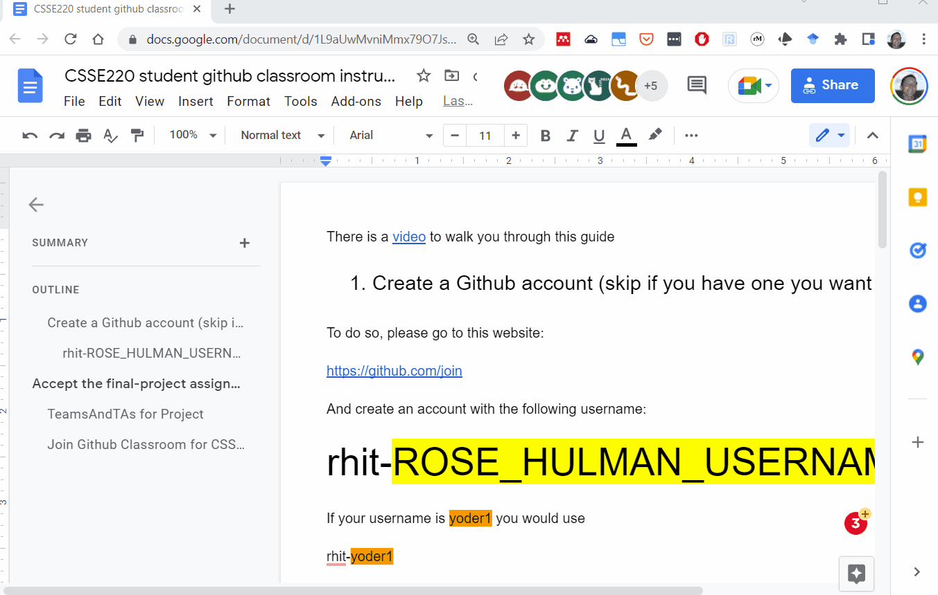

Slide 35
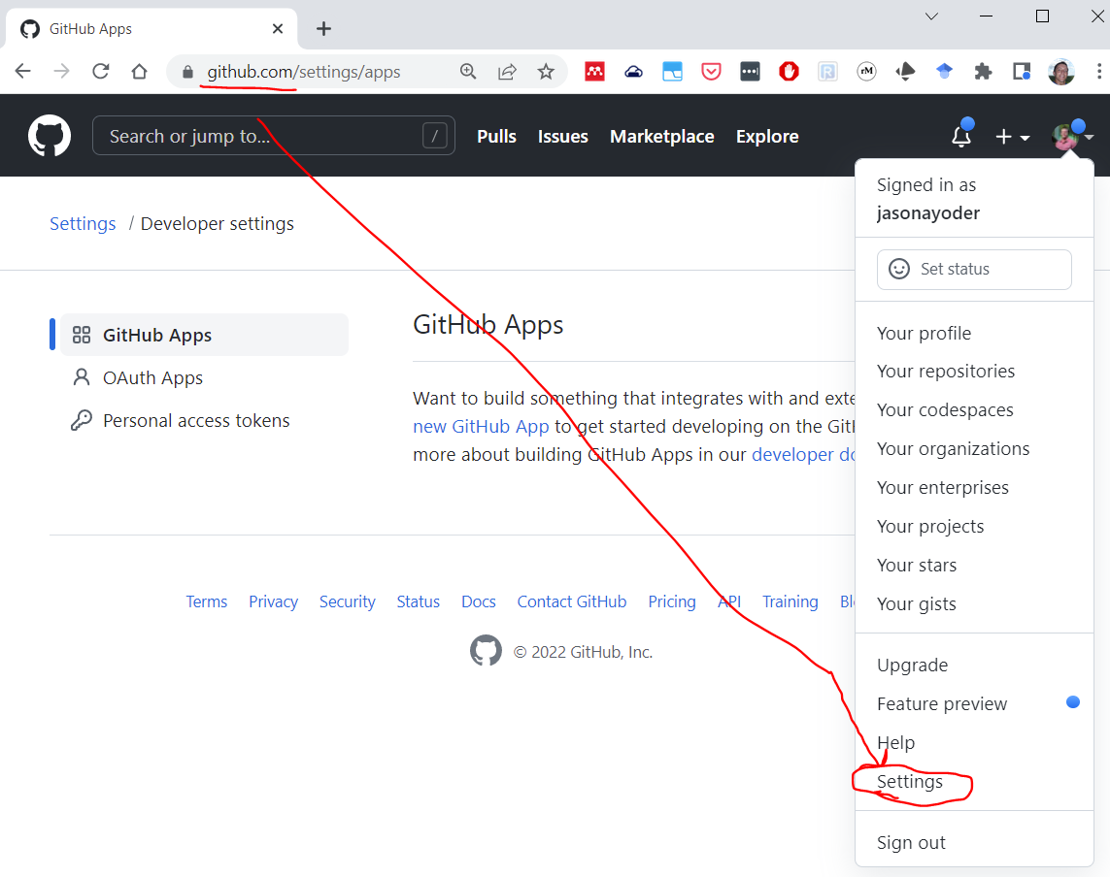
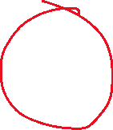
Sign into
GitHub.com
Go to your account (upper right) and then select Settings

Slide 36
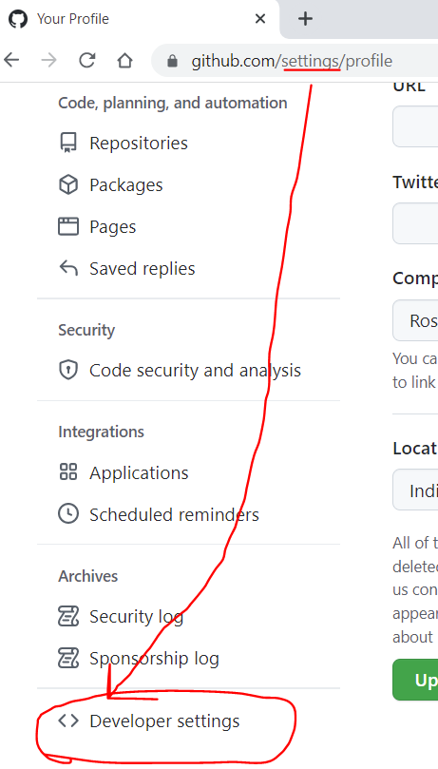
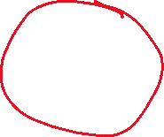

Scroll to the bottom of the settings page and select:
“Developer settings”

Slide 37
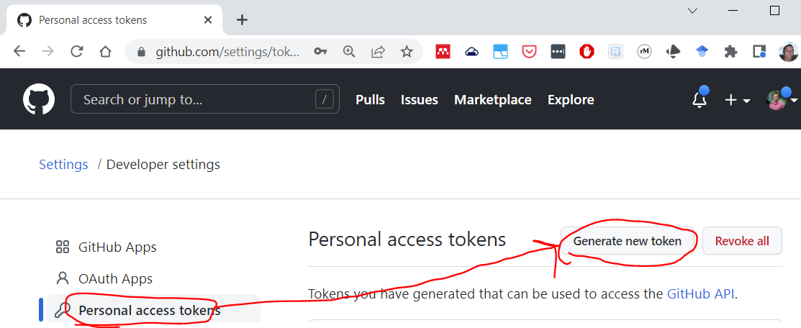
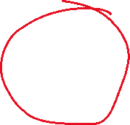

Go to Personal access tokens and select “Generate new token” and give yourself enough time to finish the course. (You can always generate more tokens later)
GitHub will only show you this token ONCE so you need to save it to be able to use it.
You can select the “Store in Secure Store” in Eclipse to be able to re-use it over and over again

Slide 38
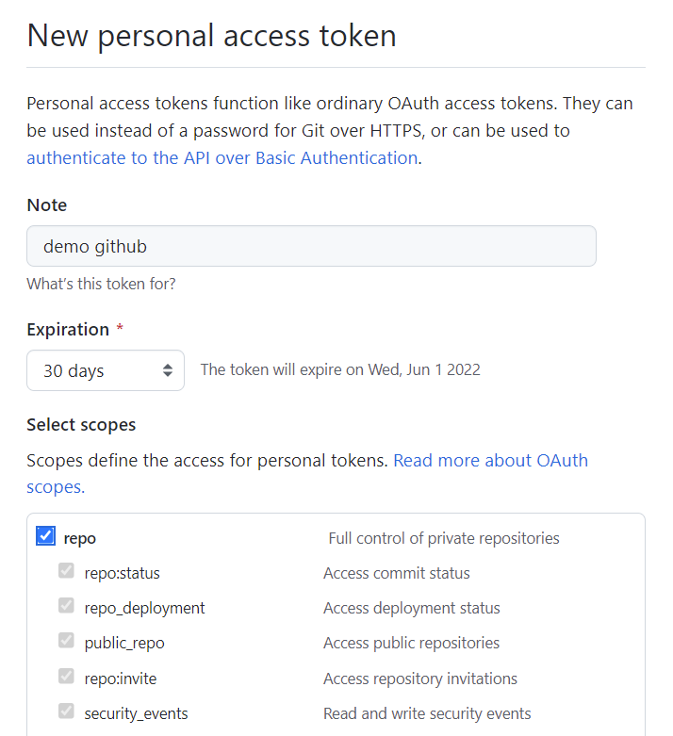
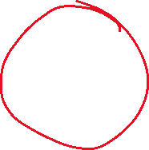
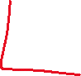
GitHub will only show you this token ONCE so you need to save it to be able to use it.
You can select the “Store in Secure Store” in Eclipse to be able to re-use it over and over again

Slide 39
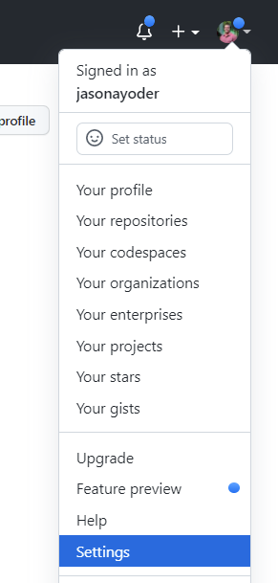
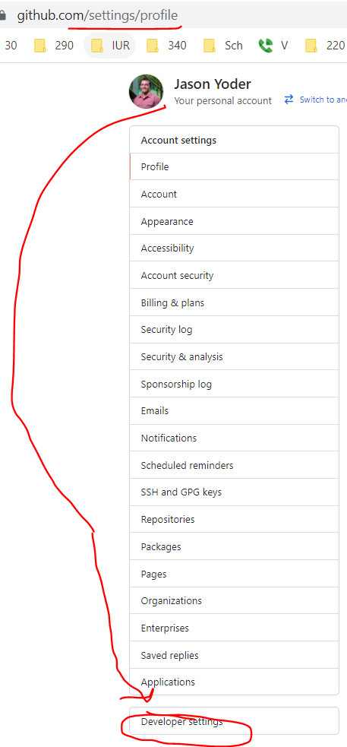
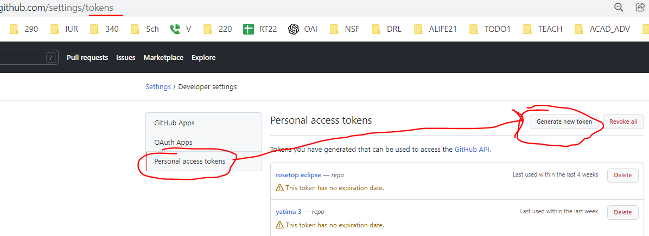
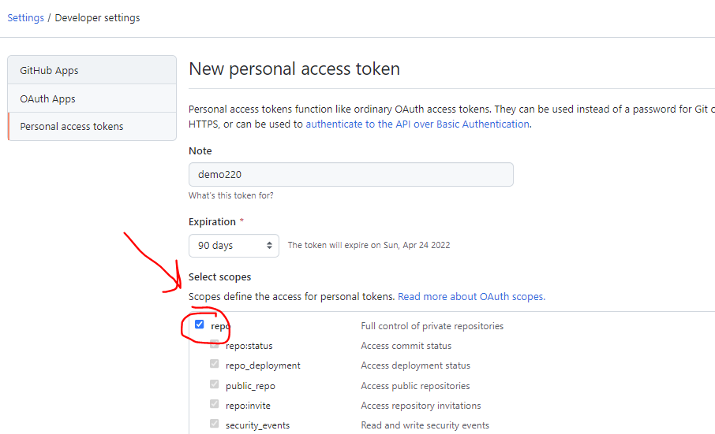
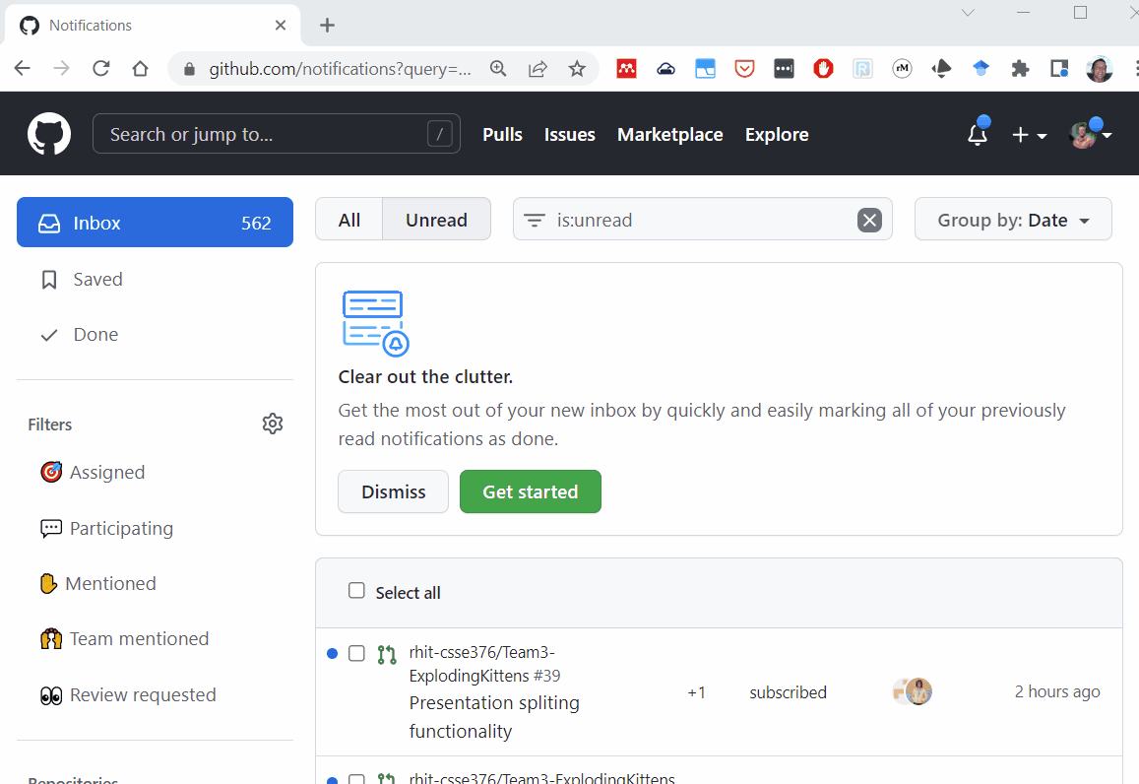






This had been shared on Piazza as well, but here it is again.

Slide 40
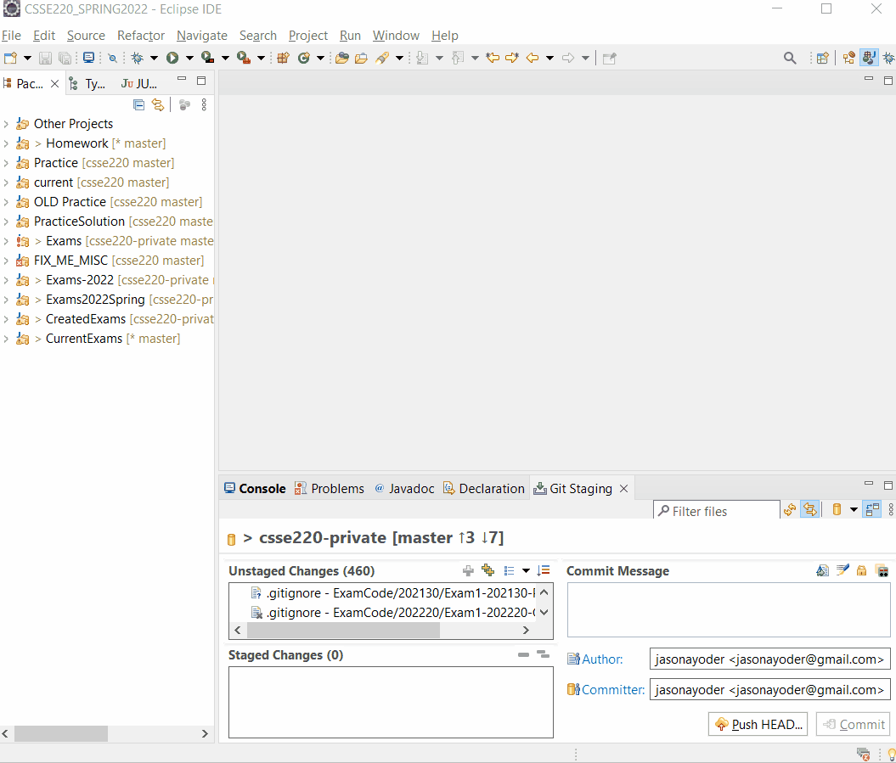
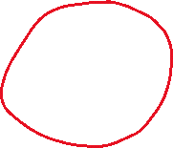

You have to use your Personal Access Token AS your password The username is your GITHUB username

Slide 41
Meeting with TA as time allows
Feedback on your UML
You can ask general questions
You can ask for advice
If you have not defined your DNR roles yet, do that now!

Slide 42
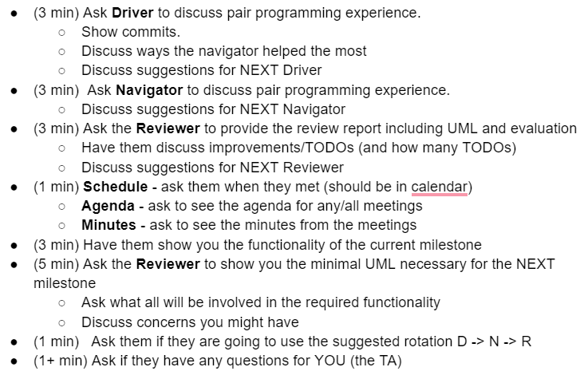
Next Meeting (Milestone 1) with your TA
Agenda and Plan
Make sure you are ready to show the TA everything you are responsible for
Must have UML for current and next milestone
Have your code ready to run
Have your git commits ready to show

